Slide 1
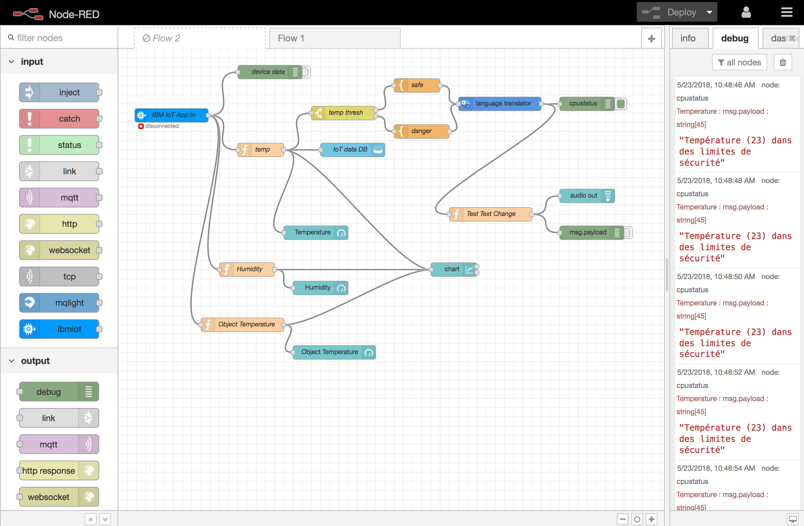
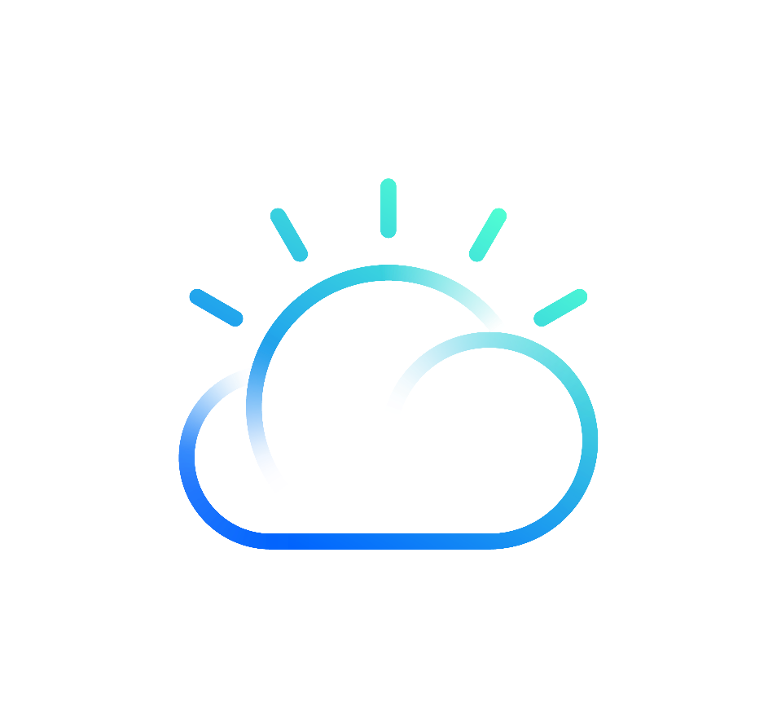
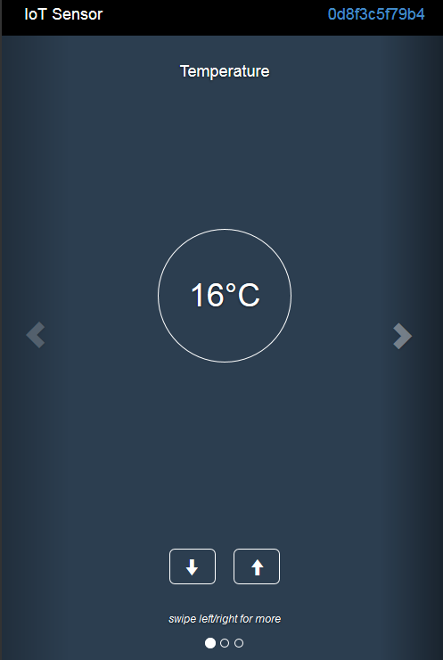

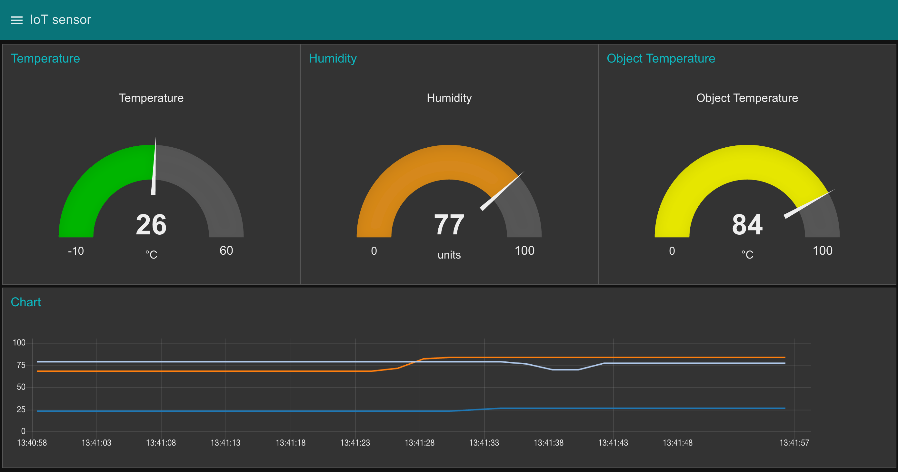

3
IBM Cloud
2
Application Server
Subscribe to Events
Publish Events
IoT Broker
“QuickStart”
3
IoT [Big] Data
processing
Collect Events
3
Watson Services AI / Natural Language Processing
Store Events
IoT Data
(Cloudant)
3
4
Virtual Temperature
Sensor
4

Slide 2
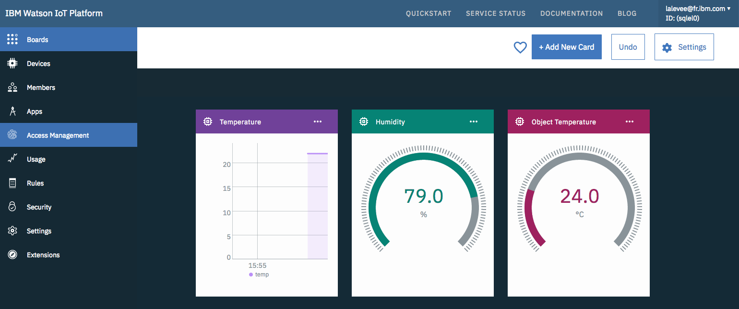
3
2
3
IBM Cloud
Watson IoT Platform
Application Server
Subscribe to Events
5
Publish Events
IoT Broker
“QuickStart”
IoT [Big] Data
processing
5
Collect Events
3
Watson Services
Store Events
Virtual Temperature
Sensor
IoT Data
(Cloudant)
3
4
4

